Slide 1
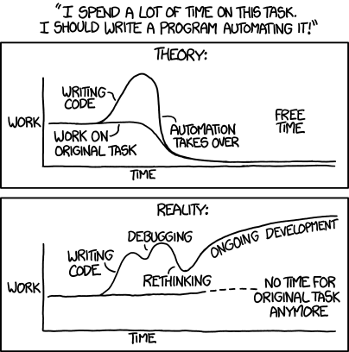
SITECORE POWERSHELL

Slide 2
TODAY’S TOPICS
1
WHAT IS SITECORE POWERSHELL?
2
WHAT CAN IT DO?
3
HOW TO USE?
4
LIVE DEMO

Slide 3
SITECORE POWERSHELL
Sitecore Powershell Extensions (SPE)
Sitecore Module
Sitecore Powershell ISE
Integrated Scripting Environment
Sitecore Powershell Console
Notes:
Module
Available on sitecore marketplace
Easily installable
Feature rich ise
Allows debugging
Watching variables
Pausing code execution
Console can be opened anywhere in the content editor

Slide 4

WHY?
Notes:
There’s the constant struggle whether to to a mundane task manually or put in the affort to automate it

Slide 5
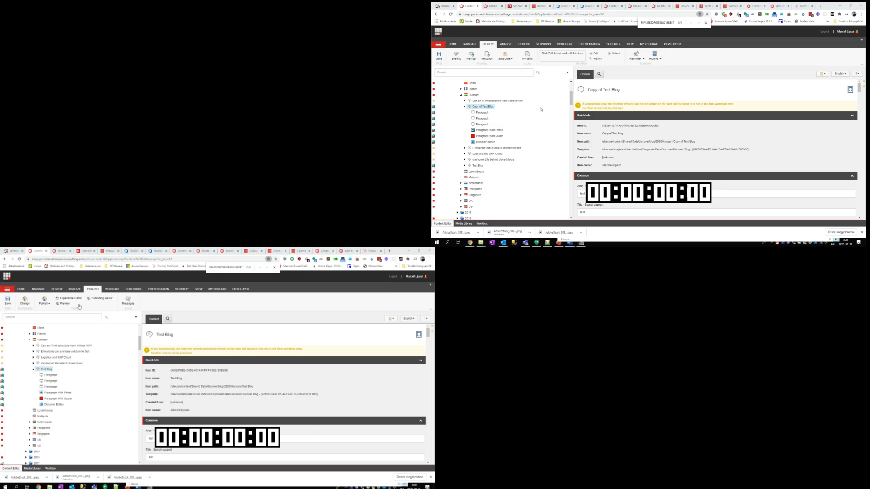
WHY?
Notes:
Here’s an example of how much you can get
Top right is the manual way
Bottom left is the automated script available from a context menu
On a new blog post all the paragraphs are separate items
This is good for structuring
They can be separately managed by versions languages
We can preview changes paragraph by paragraph
But it’s a hassle to put them through the publishing workflow
You have to Submit them and Approve them and wait for the content editor to load
This might be necessary when only one paragraph has to be changed
Or we just didn’t have development capacity to make it easier on the content editors
Either way the script is 4x faster

Slide 6
WHY?
Doing the same modification on multiple items
Email address links to contact form links
Copying multiple items
12 countries, same structure, overlapping content
Creating reports
How much content is on the site today?
Notes:
Gather all the button items on the website and change the email addresses to contact form links for security
30 new pages to be copied to all 12 countries with some local modifications
Content inventory to find outdated news or technologies, decide on what to keep and what not to

Slide 7
WHY?
Modifying multiple items from CSV/Excel
Adding categories to content
Changing renderings on a page
Replacing old components with new ones
Managing language versions
Translating in batch
Notes:
Categorizing blogs, career blogs, news, solution pages then letting the users filter on these
Rolling out new features where a new component has been developed
Copying language versions, keeping formatting, helping translation, not having to copy images by hand

Slide 8
WHY NOT? DANGERS ⚠
Editing lot of items can cause a lot of damage
Modifications are always final
Deletions might be final
Circumvents normal operation
Notes:
Unless you take the proper precautions, you can make final destructive modifications to items
You have to make sure to create new versions when you edit
Deleting and overwriting things might be unrecoverable
Backups must be created
You can break stuff by circumventing Sitecore’s general way of doing things which can lead to 500 errors

Slide 9
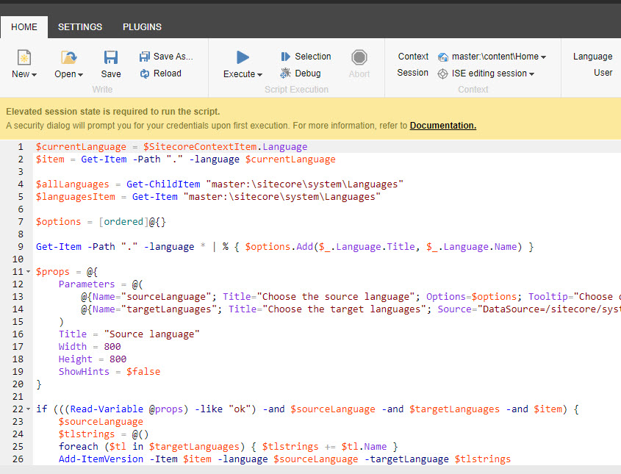
HOW TO

Slide 10
Get-Item (gi)
By path
Get-Item -path "/sitecore/content/Sites/Corporate/DBE/Home"
By ID (must specify server)
Get-Item master: -ID "{AB86861A-6030-46C5-B394-E8F99E8B87DB}"
By Query (must specify server, uses xPath)
Get-Item master: -Query "fast://sitecore/content//*[@@templatename='Hubspot Form Config']"

Slide 11
Get-ChildItem (gci)
Same mostly as Get-Item, returns array
By path
By ID
Recursive
Get-ChildItem -Path "/sitecore/content/Sites/Corporate/DBE/Home/" -Recurse

Slide 12
Foreach-Object (%), piping (|), piped variable ($_)
Get-ChildItem -Path "/sitecore/content/Sites/Corporate/DBE/Home/" -Recurse | Foreach-Object {
# This might take a while...
$_.Name
}
Notes:
Balázs: Clear vision and timing on how to proceed, Communicates to stakeholders, Staffing resources
Martin: Analyses and decomposes the requirements, Communicates to users and stakeholders, Prioritizes what we’ll work on, Testing and validation of developed funcitional requirements, Suggests optimalization and changes
Ágoston, János: Develops new features&functionalities, Troubleshooting of technical issues, Guards technical code and architecture, Creates estimations and does feasibility checks
Marcell: Creates and publishes content, guards quality and SEO of website, helps rolling out content modifications for new features, develops new features

Slide 13
Where and some operators
Used for filtering
Expects an expression that returns true or false
Comparison operators
-eq, -ne, -gt, -lt, -le, -ge
-match, -notmatch, -replace
-like, -notlike
Logical operators:
-and, -or, -xor, -not, !

Slide 14
Where and some operators example
Gci -path "./" |
Where { $_."__Workflow status" -like "{AB86861A-6030-46C5-B394-E8F99E8B87DB}"} |
% { Invoke-Workflow -CommandName Submit }

Slide 15
Integration points
Content editor
Ribbon
Context menu
Contextual ribbon
Warnings
Gutter

Slide 16
Live demo

Slide 17
Thank you for your attention! Q&A https://doc.sitecorepowershell.com/

